Slide 1
Excel Lesson 4 Entering Worksheet Formulas
Microsoft Office 2010 Introductory
Pasewark & Pasewark

Slide 2
Objectives
Enter and edit formulas.
Distinguish between relative, absolute, and mixed cell references.
Use the point-and-click method to enter formulas.
Use the Sum button to add values in a range.
2
2

Slide 3
Objectives (continued)
Preview a calculation.
Display formulas instead of results in a worksheet.
Manually calculate formulas.
3
3

Slide 4
Vocabulary
absolute cell reference
formula
manual calculation
mixed cell reference
operand
operator
order of evaluation
point-and-click method
relative cell reference
Sum button
4
4

Slide 5
What Are Formulas?
The equation used to calculate values based on numbers entered in cells is called a formula.
Each formula begins with an equal sign (=).
The results of the calculation appear in the cell in which the formula is entered.
5
5

Slide 6
What Are Formulas? (continued)
Formula and formula reset

Slide 7
Entering a Formula
Worksheet formulas consist of two components:
operands
operators
An operand is a constant (text or number) or cell reference used in a formula.
An operator is a symbol that indicates the type of calculation to perform on the operands, such as a plus sign (+) for addition.
7
7

Slide 8
Entering a Formula (continued)
Mathematical operators

Slide 9
Entering a Formula (continued)
A formula with multiple operators is calculated using the order of evaluation.
Contents within parentheses (beginning with innermost) are evaluated first.
Mathematical operators are evaluated in a specific order. (Shown in table on next slide).
If operators have the same order of evaluation, the equation is evaluated from left to right.
9
9

Slide 10
Entering a Formula (continued)
Order of evaluation

Slide 11
Editing Formulas
If you enter a formula with an incorrect structure in a cell, Excel opens a dialog box that explains the error and provides a possible correction.
Formula error message
11
11

Slide 12
Editing Formulas (continued)
If you discover that you need to make a correction, you can edit the formula.
Click the cell with the formula you want to edit. Press the F2 key or double-click the cell to enter editing mode or click in the Formula Bar.
12
12

Slide 13
Comparing Relative, Absolute, and Mixed Cell References
A relative cell reference adjusts to its new location when copied or moved to another cell.
Absolute cell references do not change when copied or moved to a new cell.
Cell references that contain both relative and absolute references are called mixed cell references.
References preceded by a dollar sign do not change.
13
13

Slide 14
Comparing Relative, Absolute, and Mixed Cell References (continued)
Mixed cell references

Slide 15
Creating Formulas Quickly
You can include cell references in a formula by using the point-and-click method to click each cell rather than typing a cell reference.
Worksheet users frequently need to add long columns or rows of numbers. To use the Sum button, click the cell where you want the total to appear, and then click the Sum button.
15
15

Slide 16
Previewing Calculations
When you select a range that contains numbers, the status bar shows the results of common calculations for the range.
By default, these calculations display the average value in the selected range, a count of the number of values in the selected range, and a sum of the values in the selected range.
16
16

Slide 17
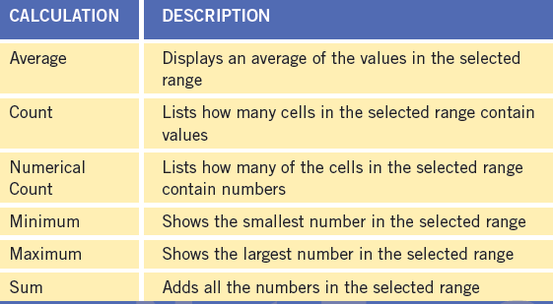
Previewing Calculations (continued)
Summary calculation options for the status bar

Slide 18
Showing Formulas in the Worksheet
At times you may find it simpler to organize formulas and detect errors when formulas are displayed in their cells.
To do this, click the Formulas tab on the Ribbon, and then, in the Formula Auditing group, click the Show Formulas button. The formulas replace the formula results in the worksheet.
18
18

Slide 19
Calculating Formulas Manually
When you need to edit a worksheet with many formulas, you can specify manual calculation, which lets you determine when Excel calculates the formulas.
The Formulas tab on the Ribbon contains all the buttons you need when working with manual calculations.
19
19

Slide 20
Summary
Formulas are equations used to calculate values and display them in a cell. Formulas can include values referenced in other cells of the worksheet. Each formula begins with an equal sign and contains at least two operands and one operator.
Formulas can include more than one operator. The order of evaluation determines the sequence used to calculate the value of a formula.
20
20

Slide 21
Summary (continued)
When you enter a formula with an incorrect structure, Excel can correct the error for you, or you can choose to edit it yourself. To edit a formula, click the cell with the formula and then make changes in the Formula Bar. You can also double-click a formula and then edit the formula directly in the cell.
21
21

